Slide 1
VA Tech Analytics Briefing
David Lyons
April 10, 2018

Slide 2

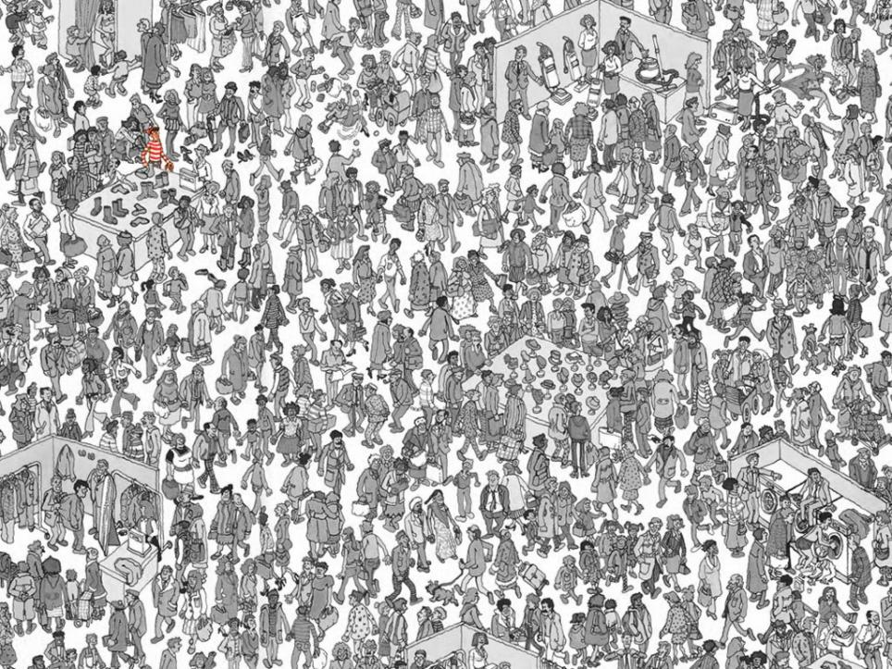



Notes:
Lets start with a fun game to get the juices flowing. Does anyone remember the book Where’s Waldo by Martin Handford? If you cant remember, he’s the character with a red and white striped shirt wearing a hat and eyeglasses. I’m going to offer a prize for the first person who can locate Waldo on the next screen. Raise your hand if you find him, ready set go (click next).
Congratulations to the winner - come on up to get your prize. With the vast amount of data, it was difficult to find what we were looking for but wouldn’t it have been easier if I had provided a better visual cue such as this? (click next)
Now any report could answer the pre-determined question such as where’s Waldo, but what about the next question or un-forseen question? Here’s where analytics really becomes valuable. Lets suppose I want to find out who Waldo has interacted with in the past 24 hours. This is not something easily done in a report or simple visualization. It requires a powerful analytical engine combined with a simple, easy to use visual interface. (click next)
I love this analogy since it really sums up what Qlik is all about – helping our customers make sense of their data and not only answer the known questions, but also the un-forseen questions using vast amounts of data. Lets segway into more on the analytics market and how Qlik is positioned. Then I’ll conclude with a hands on demo so you can see an example in action.

Slide 3
Agenda
Introductions
How we ended up in these roles
Sample data related jobs in the industry
Sample real-world customer use cases and examples of business value
Industry trends in data analytics
Live demo examples of Qlik and Advanced Analytics Integration (R, Python, etc)
Open Q+A

Slide 4

About Your Presenters
DAVID LYONS
Principal Solution Architect
4 years at Qlik, 20 years in Business Intelligence Market
  email: david.lyons@qlik.com
  Virginia Tech Graduate.
ADAM JACOBS
Federal Solution Architect,
3.5 years at Qlik, previously with Oracle
  email: adam.jacobs@qlik.com
Notes:
Twitter: If you have a Twitter handle, please include it in the opening slide. NOTE: Always expect that social media posting and tweeting will be going on in your session – unless you specify otherwise. Only ask attendees to refrain from tweeting/posting/social commenting if you are presenting confidential, proprietary, or forward-looking information. At the beginning of your presentation say something to the effect of: “The Twitter hashtag we will be using for the event is #qonnections. When tweeting about the event, include this hashtag so your tweet will be grouped with all the other tweets from the conference.”
To insert headline: Click where indicated and start typing.
To edit text: Click on placeholder bulleted text, delete it, and type in your own bulleted list.
To add pictures: Right click on picture icon in boxes. Locate picture. Click insert.
To resize pictures larger than picture box:
Click on image and right-click with mouse.
Select “Size and Position.”
Set all “Crop From” values to zero.
Adjust height and width as desired by clicking “height” and “width” arrows.
Click “Close.”
Left-click on image.
Use arrow keys to “nudge” image into desired position.

Slide 5

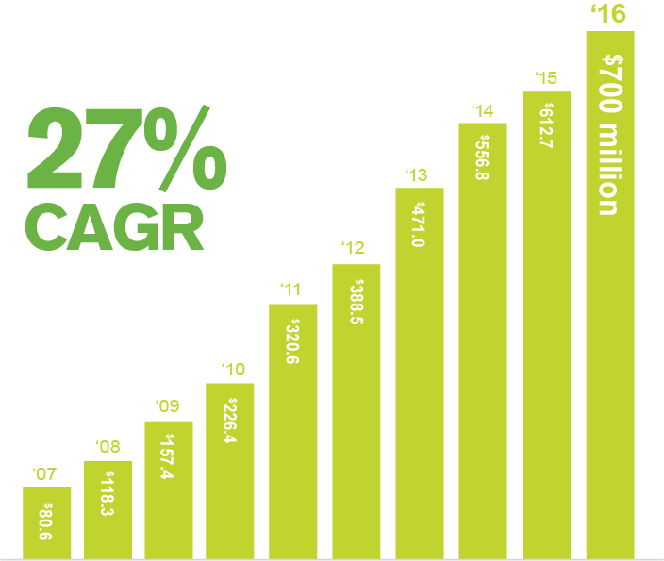


45,000
1,700
100
Founded in Lund,
Sweden in 1993
Headquartered in
Radnor, PA, USA
40,000 customers and
1,700 partners in more than 100 countries
More than 2,400
employees
* FY 2016 $700M USD Revenue
Notes:
First let me start by telling you a little about Qlik…
Founded in Lund, Sweden and now headquartered in Radnor, PA, USA we now support over 40,000 customers, work with 1,700 plus partners across more than 100 countries. We have over 2,400 employees.
Perhaps more critical is Qlik place in the market. In 2016 our revenue exceeded $705m. Our growth, over the last 10 years, 27% CAGR, exceeds that of the overall BI market, which is growing at roughly 8-9% per year. We are continuing to invest and innovate, and continuing to disrupt the market. Qlik Sense, and our unique ability to let our customers see the whole story that lies within their data is today at the heart of that growth strategy.
In this presentation I want to explain how…

Slide 6
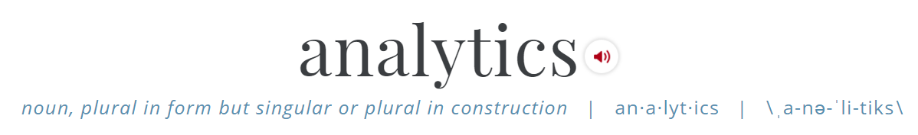
The discovery, interpretation, and communication of meaningful patterns in data.

Slide 7

The coming flood of data
Source: Intel (August 2016 webinar)
The rise of connected things and machines
by 2020:
Generating tremendous amounts of data
every day in 2020:
50B DEVICES
1.5 GB
INTERNET USERS
PER DAY
212B SENSORS
4,000 GB
SELF-DRIVING CARS
PER DAY
47% CONNECTIONS
40,000 GB
CONNECTED PLANES
PER DAY
1 MILLION GB
CONNECTED FACTORY
PER DAY
WILL BE MACHINE TO MACHINE
Notes:
Business data not fully leveraged today
Explosion in future – IOT, sensors, machine data, big data, data lakes…
Intel: 50b devices, 212b sensors, 50x growth by 2020
==== text ====
If you take a step back to think about the volume of data available to us today, it’s mind boggling to think we hardly make sense of current data let alone the onslaught of data coming in the future.
Think about the rise of “Internet of Things”: Intel projects there will be 50b devices and 212b sensors which will generate exponential amounts of data. Some say the world’s data will grow by 50x by 2020.
==== note to presenter ====
Either use this slide or a combination of the next 3 (hidden) to lay the big data and IOT foundation message

Slide 8

Notes:
Challenge: Providing Analytics to Everyone:
Most Analytics Users are not Data Scientists
Helping the user find relevant and contextual information
Ensuring the solution can accommodate today and tomorrow
Able to use different methods for different data volumes and complexities
Business users want simple, guided access Instead of having to search through everything

Slide 9

There is a broad spectrum of needs and analytics use cases across any business, all of which are important
automated
pre analysis
VISUALIZATION
storage
reporting
mobility
preparation
analytic
apps
high performance
databases
collaboration
and sharing
acquisition
embedded
analytics
Source: “The Digital Universe of Opportunities: Rich Data and the Increasing Value of the Internet of Things” – April 2014
Notes:
….However….visualization alone is not the answer.
Turning data into pretty pictures quickly is not enough. To solve real business problems you need to poke and prod and dig deeper into the data to see how the parts are related to the whole. Simple visualization tools can’t do that.
Yes, visualizations are important, just not sufficient. But they are just one step in the journey of data exploration and discovery. Customers need more.
Intent of Slide:
Now it’s time to broaden the discussion beyond a single use-case of self-service visualization and analysis. I.e., this is one of many applications of analytics that any organization will need, and it should be part of a broader solution, not the only solution. The key phrase here is that it is “necessary and important, but not sufficient.”

Slide 10





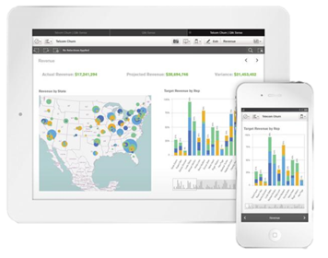

Qlik® Visual Analytics Platform
Self-Service
Data Visualization
Guided Analytics
Embedded Analytics
Custom Analytics Applications
Reporting and Collaboration
Mobile
Decentralized analysis and exploration for individuals and groups
Centrally deployed guided analytics to multiple knowledge workers
Analytics embedded in web and enterprise applications (Sharepoint, Salesforce, etc)
Custom-built analytics applications for internal and external use
Pixel-perfect report distribution across the enterprise
Online and Offline; Responsive web design
Associative Engine Technology, APIs, Toolkit, Security
Notes:
This portfolio of solutions, powered by our platform approach is what enables Qlik to support a full breadth of analytics use cases.
Self-service data visualization supports the decentralized deployment of analytics and enables self-service exploration of data for individuals and groups. Applying governance in a self-service environment is becoming increasingly important.
Guided analytics, often referred to a governed data discovery by Gartner is about the centralized deployment of business intelligence and analytics via pre-built dashboards and reports to multiple knowledge workers across the business and which align to a particular business process or workflow i.e. marketing performance dashboards, sales performance etc.
Embedded analytics refers to the embedding of analytics, dashboards and visualizations in a internal or external facing website/intranet/extranet or other enterprise application, often for a specific audience or align to a specific business process the enterprise application supports.
Custom analytics applications are those built by for example a web developer to support a specific business process or use case. For example a custom built application looking at travel or expense management, sales performance etc
Qlik Sense enterprise and our underlying platform support all of these use cases. Customers just looking for an embedded or custom use case can leverage the Qlik Analytics Platform package.
The final use case, Reporting and collaboration supports the centralized creation and automated distribution of pixel perfect reports to a broad range of users across the enterprise and is supported by our NPrinting offering.

Slide 11
Technology
Process
People
Notes:
- PEOPLE, are the foundation of building a data-driven culture. That’s right. And that’s coming from a person working for a technology software company!
- PEOPLE, are the foundation of building a data-driven culture.
Technology is an enabler for decision making, but PEOPLE make business decisions
As much as I love Qlik and think it’s the best technology on the market, I also have seen projects fail where the People are not engaged and there’s no process
- So the start of building a data-driven culture, is about investing in people.
===== longer version =====
No technology is going to take over all the decision-making we need to do day-in and day-out, to effectively run and manage our organizations. At least not in our lifetime, and not sure I’d want to be around if that ever does happen!
People are at the heart of decision-making. And people are the ones that ask both the intuitive, and maybe not so intuitive questions that can be explored in data. They are the ones that have a never ending supply of curiosity that compels them to dig deeper, to take a look at it from a different angle, to play exhausting games of “what-if”, and ultimately to interpret their findings. So the start of building a data-driven culture, is about investing in people.

Slide 12







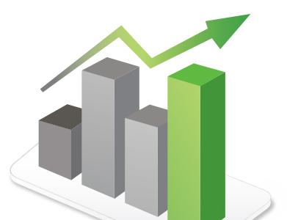
Repeatable Qlik® solution areas by Function
Finance
Financial Planning
& Analysis
Expense Management
Revenue & Profitability
Cash-Flow & Balance Sheet
Risk & Compliance
IT as a User
Helpdesk Management
IT Infrastructure
Software & License
Network Governance
Human Resources
Workforce Management
Total Rewards
Recruitment
Marketing
Campaign Performance
Customer Segmentation
Web Analytics
Operations
Production Efficiency
Operational Risk
R&D and Innovation
Customer Service/Call Center
Supply Chain
Planning
Performance & Efficiency
Risk & Resilience
Sales
Sales Representatives
Sales Management
Sales Operations
Notes:
Public facing slide

Slide 13






Common Qlik® Sales Solution Areas
Pipeline & Quota Management
Actionable account planning
Optimize compensation and quota plans
Visualize lead & opportunity progression
Improve forecast accuracy & conversion rates
Single view of leads, contacts, accounts & campaigns
Customer Analysis
Rapid customer segmentation
Create custom targeting & call lists
Improve acquisitions & renewals
Reduce churn
Understand historical purchasing patterns
Improve customer satisfaction & advocacy
Product Analysis
Optimize promotions & discounting
Increase profitability & margins
Improve availability, configuration, & mix
Increase cross-sell / up-sell opportunities
Proactively respond to end-of-life, seasonality and supply/demand models
Channel Analysis
Improve territory design
Holistic multi-channel visibility
Align forecast models with growth
Improve channel relationship management
Achieve cross-functional alignment
Identify new investment opportunities
Sales Planning
Predict resource and growth allocation
Operationally integrate with financial profitability needs and marketing campaigns
Achieve agile territory analysis
Understand true COGS and expense analysis
Optimize forecasting & budgeting

Slide 14
$100
MILLION
in added revenue at
Cisco Systems
Qlik has enabled this multinational networking equipment company to:
Find and act on revenue opportunities, generating $100 million in added revenue
Access large amounts of data through easy-to-use dashboards and real-time “wild card” searches
Monitor sales support and service contracts
Identify risks and address issues, saving $4 million in costs
$4 million
in cost savings
“Qlik is regarded as the primary opportunity platform for services in our organization and has been a total game changer.”
- Demian Barshay, Manager, Operations, Cisco Systems

Slide 15
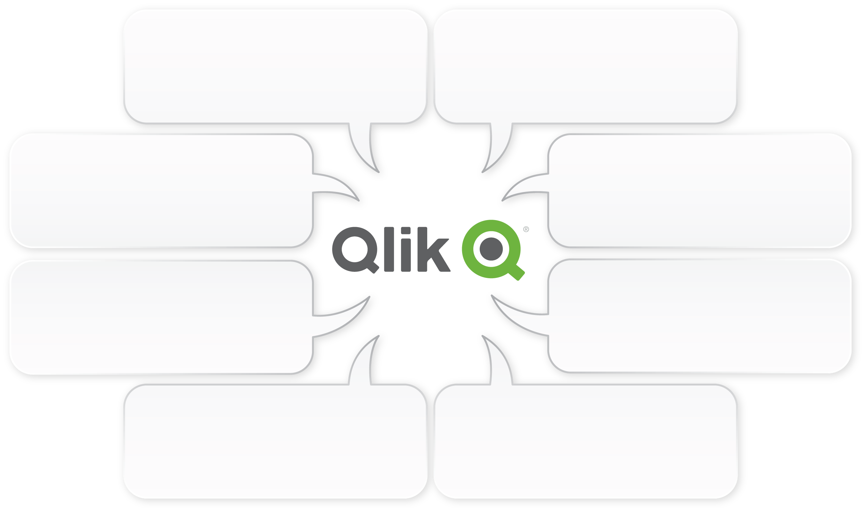
Example Qlik Apps across the Supply Chain
Returns and Repairs
Service Management
Service Parts
Warranty Management
Quality Analysis
Reverse Logistics Analysis
Repair, Replacement, End-of-Life Disposition
Executive Insights
Executive Dashboard
Balanced Scorecards
Performance Analysis
Safety and Regulatory Compliance
Transportation and Logistics
Inbound and Outbound Transport
Air, Cargo, Rail, Mode Analysis
Third Party Logistics, Carrier and Delivery Analysis
Global Transport / Cross Border
Variable Cost and Lead Time Analysis
Shipping and Receiving Analysis and Alerts
Supply Chain Strategy
Supply Chain and Network Design
Predictive / ’What-If’ Analysis
Multi-Division and Multi-Tiered Analysis
Outsourcing and Partnership Analysis
Supply Chain Sustainability
Warehousing and Distribution
Warehouse / Distribution Center Operations
Picking Accuracy and Fill Rates
Throughput Analysis and Tracking
Order Management and Fulfillment
Wholesale Distributor Analysis
Forecasting and Planning
Demand Planning
Financial Planning
Sales and Operations Planning (S&OP)
Collaborative Planning, Forecasting and Replenishment (CPFR)
Category / SKU Rationalization
Production
Production Planning and Scheduling
Production Efficiency
Inventory Management
Quality Control Analysis
Maintenance Repair and Overhaul
Event Management
Sourcing and Supplier Performance
Strategic Sourcing
Contract Compliance and Management
Procurement Analysis
Buyer / Supplier Productivity

Slide 16
Common Qlik® Finance Solution Areas
Financial planning & analysis
Putting the “A” back in FP&A
Optimized budget allocations
Improved financial decisions
Blend “top-down” & “bottom-up” forecasting
Cost reduction and increase revenue
Expense management
Leverage expense under-runs
Deliver month on cost & manage exceeding costs
Greater assessment of true cost ownership and real value of contracts
Cost reduction and increased profit
Cash flow & balance sheet
Reduce aged receivables
Improve customer service
Streamline cash flow and increase asset efficiency
Integrated treasury functions & visibility
Cost reduction and increased revenue
Revenue & profitability
Reduced slippage, risks, and underperformance
Eliminate communication lag time
Increased margins and revenue
Increase product and market opportunities
Improved product portfolio performance
Risk and compliance
Align governance models with strategy
Transparency with management and regulators
Decrease risk, fines, penalties, and fraud
Improved ad-hoc compliance & risk investigation

Slide 17


Decreased
budgeting
process from
914
HOURS
2
Qlik has enabled the agency to:
TO
Identify cost, risk, and performance of programs
Perform what-if scenario analysis to see risk associated with budget cuts
View the entire portfolio across the Agency to make informed funding decisions
“Qlik has not only improved our annual budget planning process, but it’s enabled us to quantify
and justify the investments made in our national security programs.”
Notes:
NSA uses Qlik to assess budget allocation/spend and the associated risk of cutting funding for particular programs.
Qlik’s champion encourages his team to try new things as it relates to analytics, rather than waiting for the data be perfect. “Fail fast and fail forward is his motto”—make mistakes, learn from them, and move on
2015 NextGov Bold Award Winner for use of Qlik

Slide 18


Reconciled
$110B
at 45% of projected cost
and in half the
estimated time
Qlik has enabled the agency to:
Analyze the entire DoD Universe of
Transactions: >2 billion transactions
Connect more than 30 business systems
Support 6 different audits from 24 Defense Agencies
Achieve audit readiness for the first time in history
“We’ve achieved something that others had been trying to accomplish for decades.”
Notes:
Background (from Fed 100 Nomination)
Describe this person's job, and the work for which he or she is being nominated
In 2017, the DoD was preparing for their first ever full financial statement audit in 2018 — the single largest financial statement audit in history. Greg Little was tasked with developing a technical and functional solution to resolve the DoD’s toughest audit deal breaker: a Universe of Transactions (UoT). A UoT is a data repository that demonstrates to an auditor that management is performing financial reconciliations and can be used for audit sampling. The challenge in developing a UoT is that there are 30 different systems in scope, non-standard data, and a tremendous volume of data. To address these challenges, Greg introduced the financial community to agile project management principles and big data and visual analytics technologies.
In a span of one year, Greg secured funding from Congress, chartered a steering committee consisting of DoD CIO, Comptroller, and Defense finance and accounting senior leaders, and developed the technical solution for UoT. Greg implemented big data technologies to ingest over 2 billion transactions from more than 30 business systems to support 6 different audits from 24 Defense Agencies. As a result, the DoD has been able to reconcile $110 billion dollars. This effort has resulted in system changes and an improved system consolidation strategy to improve the DoD’s data.
Greg’s work is now being used as a model for other analytics and big data projects throughout the DoD. The success of this effort has created a foundational capability for other financial management analytics initiatives that simply were not possible prior to Greg’s work.
What impact did this work have? How did the nominee go above and beyond to make a difference?
Greg’s leadership of the UoT was transformational—he made the DoD audit ready. Without his work, the DoD would not have been able to comply with the congressionally mandated audit readiness deadline of September 30, 2017.
Greg volunteered to manage the UoT project, despite the fact that it had failed in the past. He embraced agile principles and new big data and visual analytics technologies to complete the task. His work produced some amazing results:
Original cost estimate was estimated at $20 million. Greg was able to achieve the results for under $9 million
Original schedule estimate was 24 months. Greg completed the task in 12 months.
Greg was able to shut down 3 data warehouse projects that were going to provide redundant capabilities
First agile open source big data project in DoD back office operations
Greg was successful because he started with the business problem and then figured out the best technologies to meet the requirements quickly and affordably.
If needed, provide any additional background information to support this nomination
Greg’s ability to deliver results quickly is based on a relentless pursuit of technology and teamwork. He understands how existing tools and processes can be replicated and improved upon in a modern, open source, and low-cost framework. He spends days and nights on the phone with team members, partners and decision makers, building trust and confidence along the way. His focus on delivering results every four weeks sets the tone for aggressive capability delivery and proof that iterative and agile development is possible in a policy organization.
Greg surrounds himself with the best and brightest innovators in technology and fosters forward thinking by breaking down traditional barriers to collaboration. For instance, Greg demands a “badgeless” culture to instill teaming—it is impossible to tell who is a civilian versus a contractor, or the company or agency where someone works. He leads by example, setting a pace that is uncommon in the Federal workplace. Observers of Greg’s work typically comment on his unusual but effective style and almost everyone Greg works with agrees that he will be major Federal

Slide 19
Common Qlik Human Resources Solution Areas
Workforce Management
Monitor productivity trends and absenteeism
Assess learning offerings against enrollment and performance
Deep analysis of employee management, training, and production
Improve succession planning, staffing resources, and on-boarding
Improve employee relations, contract administration, and reporting
Align financial, legal, and regulatory compliance with HR operations
Recruitment
Increase internal engagement levels
Decrease time to fill/time to productivity
Enhance recruiting pipeline and employee leads
Increase retention levels & reduce turnover and hiring costs
Forecast organizational structure based on current hiring and promotional practices
Improve quality of candidate pool through holistic labor market availability visibility
Total Rewards
Monitor total payroll costs, benefits costs, overtime spend, and variable compensation
Analyze employee compensation against performance
Gain deep understanding of benefit plans and employee resource forecasting
Provide holistic view of total benefits from disparate source systems and 3rd party data

Slide 20
IT Information Sweet Spots for Qlik
Servers
  Usage, CPU, memory, storage, bandwidth, I/O, processes, up time, backup, files
  Logins, failures, sessions, application errors, modules loaded, warnings, performance
Security
  Access, authorization, authentication, policies, encryption, certificates, intrusion, LDAP
Hardware
  Activity on switches, routers, desktops, notebooks, servers, peripherals, mobile
  Inventory, procurement, plans, leasing
Web Activity
  Domains, pages, visitors, attacks, robots, sessions, content, search, locations, browsers
Software
  Licenses, O/S, auditing, updates, viruses, authorized, service packs, patches
Email
  Quotas, spam, attachments, activity, sizes
Network Topography
  Routers, backbones, switches, proxies, load balancers, network maps, traffic
Identity and Access
  User accounts, domains, expirations, locked, disabled, passwords, group memberships
Database
  Tables, users, applications, fields, data types, connections, sessions
QlikView
  QlikView Applications, data files, sessions, tasks, errors, warnings, expressions, columns, filters, data lineage, impact analysis, QlikView-specific metadata management, governance
Project Management / SLA / Support / Help Desk
  Upgrades, new software installations and project rollouts, case management

Slide 21


Provided
400+
ANALYSTS
Qlik has enabled the agency to:
with the ability to analyze
their region’s environmental
health & safety data
alongside national
data.
Analyze environmental health
& safety info across regions
Empower 400+ analysts across the country
Improve analysis of pollution data, water quality, etc.
“Our Agency’s insight has improved tremendously, and we’re just getting started!”
Notes:
About EPA:
Protects human health and the environment
Develops and enforces regulations
Gives grants and studies environmental issues
Educates people about the environment
Challenges:
Needed to provide agency-wide visibility and self-service analytics to field analysts
Legacy analytics (Business Objects) too slow and unresponsive
Solution:
BI/Analytics Center was Oracle, BOBJ, but too slow and not responsive (most found it to be slow and were doing their own thing in the field with a variety of tools.
Implement Qlik Sense to analyze environmental health & safety info across regions
Provide Qlik Sense to 200+ analysts across the country
Benefits:
-Within 30 days of standing it up (before announcement) they had 100 users
-currently at 200 users and growing
-Analysts across the country in every region analyzing environmental health & safety info in their geography (i.e., Region 3--pollution, water quality, etc).

Slide 22


92%
REDUCTION
Qlik has enabled the agency to:
In response time
Improve RFI response time from 15 days to same-day
Repurpose 2 FTEs from manual reporting to analysis
Improve interagency collaboration and ability to identify and stop narcotics trafficking
“Within 3 months of implementing Qlik, we reduced our RFI response wait time by over 92% and
reallocated 50% of analyst staff from manual data compilation to more value-add projects.”
Notes:
About EPIC
Tactical intel center led by the Department of Justice’s DEA
Fights war on drug trafficking and related threats to national security
Focal point for sharing intelligence on narcotics trafficking and seizures across the US
Hosts representatives from 21 different agencies and provides information to over 19,000 law enforcement officers and analysts
Challenges
Primary reporting tool (BO) was costly and had limited analysis, flexibility, and exploration for users
Difficult to pull together data from multiple sources quickly, resulting in limited scope of trafficking trends and patterns
Long Time to respond to RFIs and produce relevant up to date reports restricted insight for day-to-day decisions
Solution
7+ Qlik apps deployed to 20,000+ inter-agency portal users
Analysts and law enforcement directors are now able to easily identify trends and uncover anomalies in narcotics seizure data
RFI turn around time in 3 clicks (or less than 24 hours) instead of 15 days and 2 FT analysts as before Qlik
Geographic data mapping provides insight unlike ever before to every type of user
Replaced 1000+ static BO reports with 3 QV apps for 20,000+ users
Benefits
Earlier identification of areas needing additional investigation
Improving interagency collaboration to intervene and stop narcotics trafficking with faster time to insight from disparate interagency data, call center intelligence, and historical trends

Slide 23
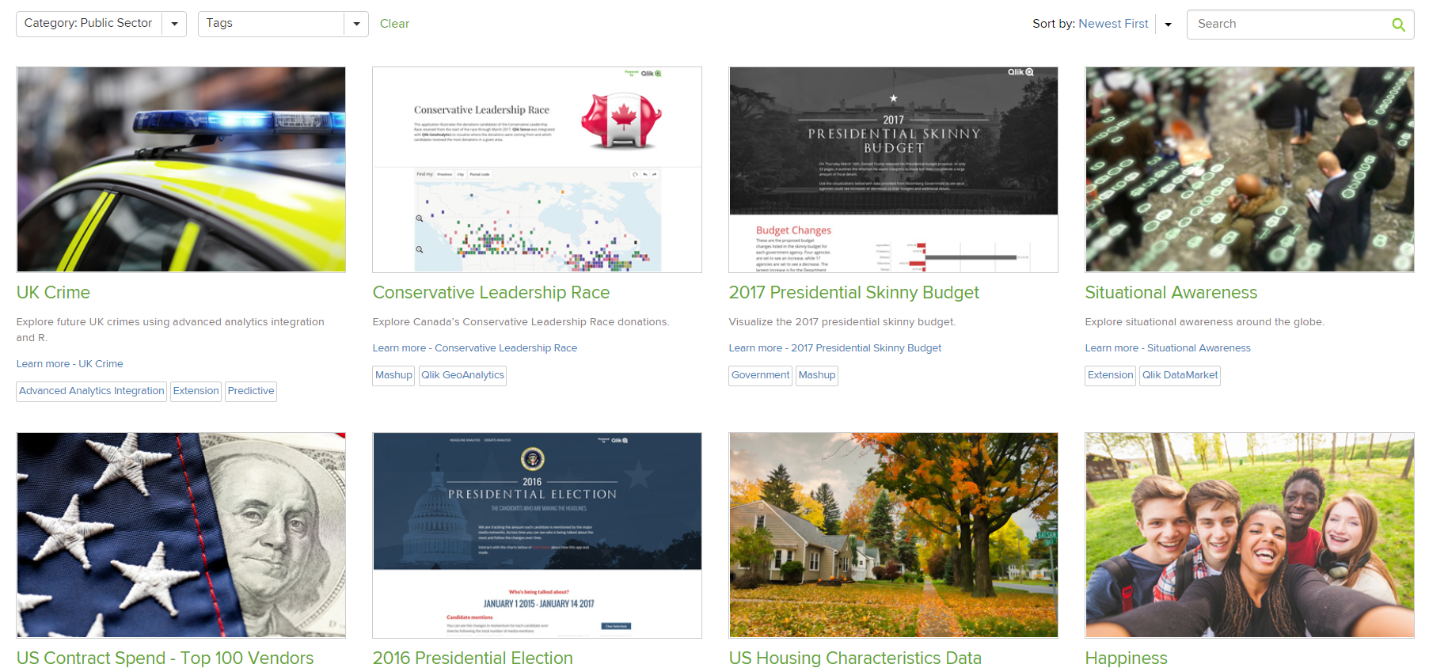
Live Demo! http://Demos.qlik.com
FDA demo: https://fis.fda.gov/sense/app/777e9f4d-0cf8-448e-8068-f564c31baa25
Contract Spend: http://cloudera.qlik.com/demos.html

Slide 24
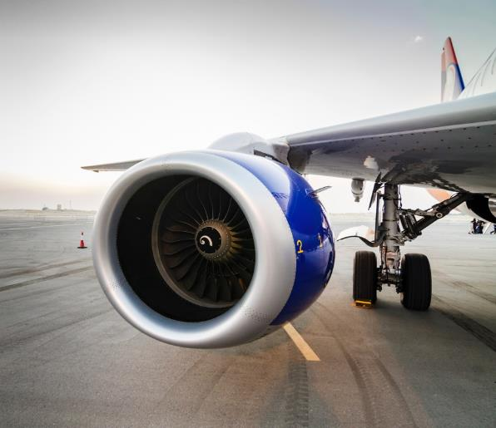

22%
INCREASE
in supplier on-time delivery
in one year at
DynCorp International
Qlik enabled this contractor to:
Establish a single source of truth for supply chain performance
Improve visibility on all fronts,
enabling faster and better decision making
Utilized resources more effectively;
now managing by exception
Increase the value that the supply chain
team has to the organization
Engage multiple business units globally to use the dashboard and filter based on relevant criteria
  “We saw a massive benefit from using Qlik for a true enterprise view of the business. We’ve seen hard-dollar savings from shortening time to problem resolution, driving the right supplier relationship, and getting smarter in how we negotiate deals.”
  - Bill Momsen, Senior Director of Supply Chain Operations, DynCorp International
Notes:
Salesforce + SAP on AWS cloud
Food, medicine, clothing due to famine, war & natural disaster
111M pounds of food per year supplements 760K meals a day. Has operated in 119 countries
Q provides viz into 100,000’s of items. Track inventory levels and availability from individual SKUs to broad categories to determine readiness to provide aid.
Commodity tracking app helps the VP of Warehousing ship the right stuff in the right order with real-time viz into expiration dates on food & medicine.
Donations app tracks trends & id’s potential shortfalls to focus fundraising.
IT uses Qlik for change management, helpdesk efficiency & asset tracking

Slide 25
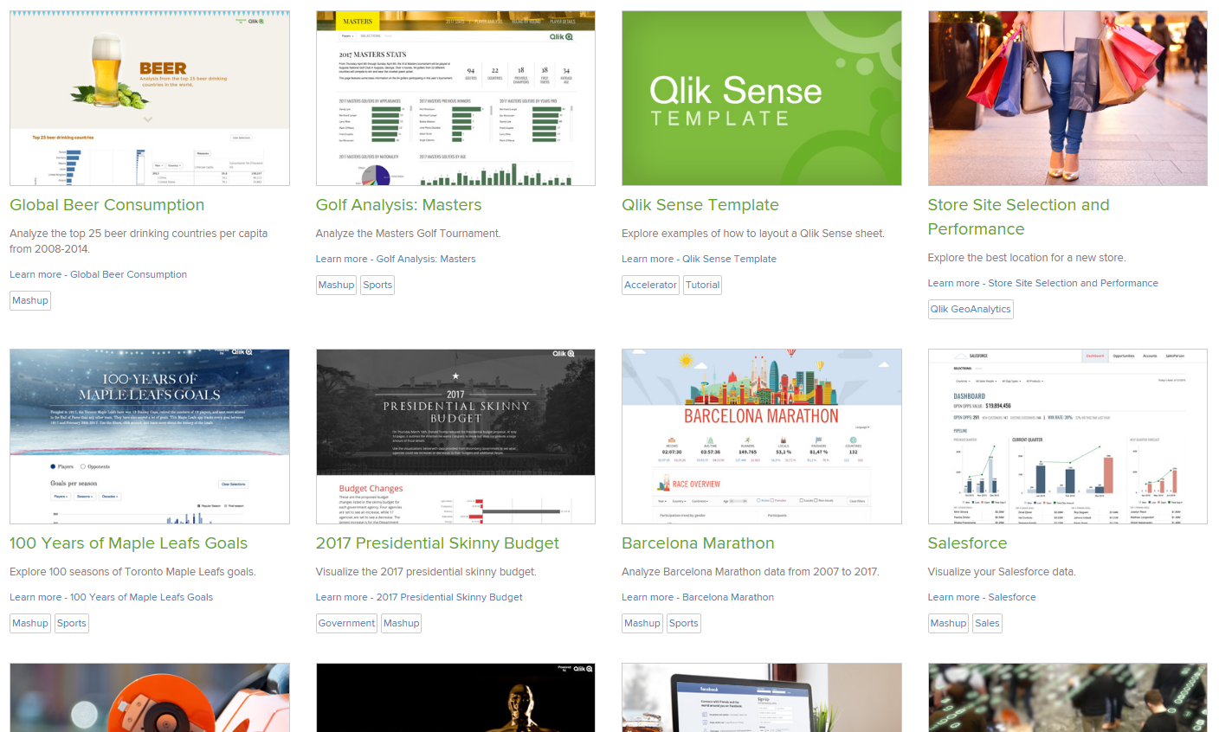
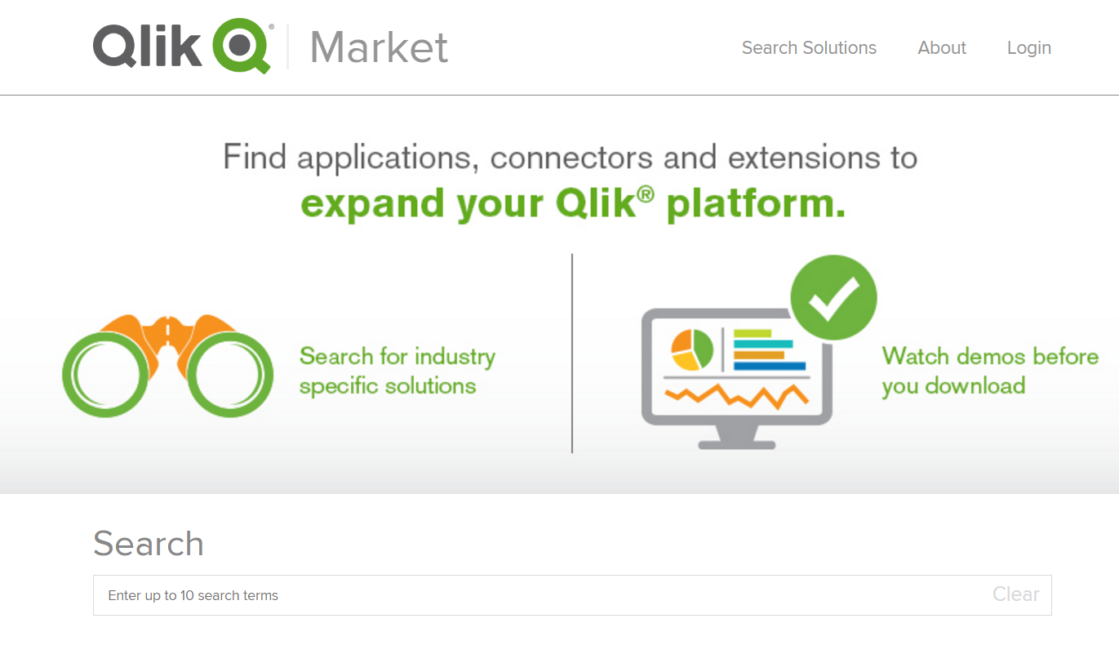
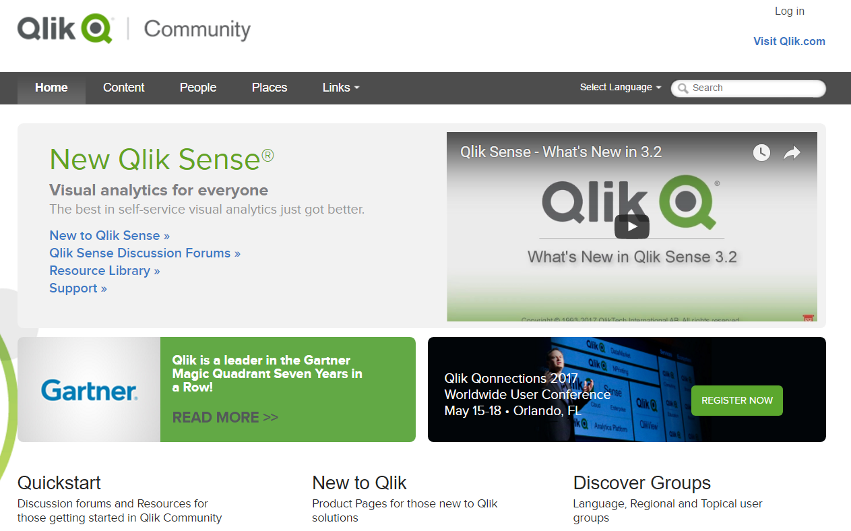
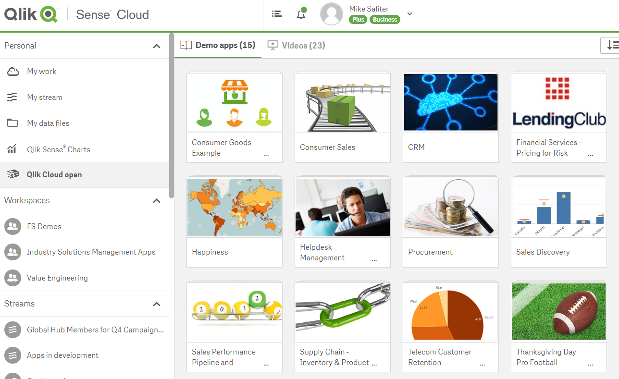
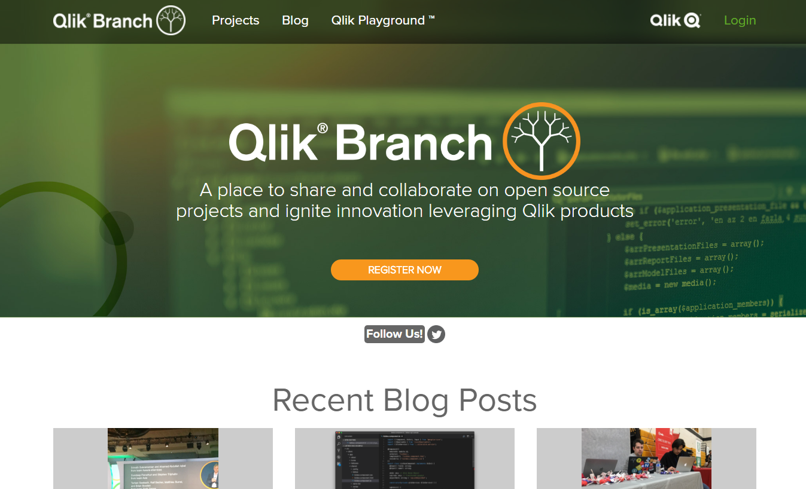
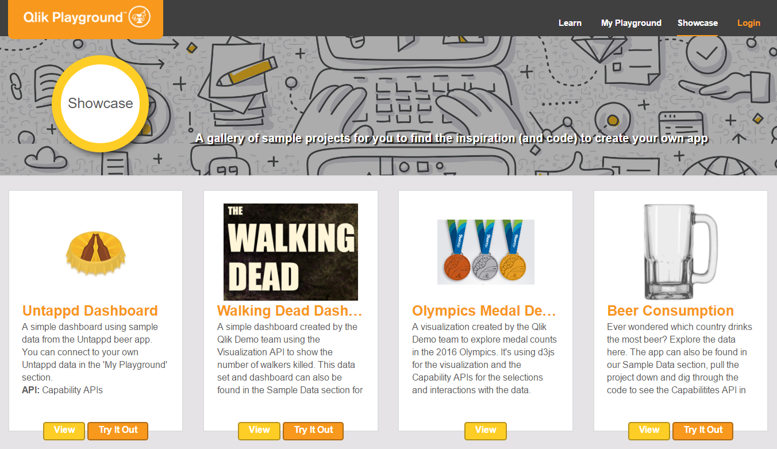
Publicly Available Solution Content
Qlik Demos Site
(160+ apps)
Qlik® Market
(300+ Partner solutions)
Qlik® Community
(100k+ users)
  demos.qlik.com
  market.qlik.com
  community.qlik.com
Qlik® Sense Cloud
(15+ sample apps – more coming)
Qlik® Branch
(450+ open source projects)
Qlik® Playground
(7000+ developer sessions / mo)
  qlikcloud.com
  branch.qlik.com
  Playground.qlik.com
Notes:
Not only does Qlik support all of your data from a single platform through an a differentiated associative engine, but we also have a mature ecosystem of partners, services and solution content resources to help you on your analytics journey
Here are a few of the key websites you can leverage in the public domain starting today:
Qlik Demo Site: 160+ QlikView, Qlik Sense (native) and Qlik Sense mashup apps with more coming. Many are downloadable too
Qlik Market: 100’s of Partner solutions where you can showcase your offerings for free using Qlik’s storefront
Qlik Community: 100k+ users sharing, collaborating and posting best practice solution examples
Qlik Sense Cloud: avoids desktop need and comes with samples apps to explore and share
Qlik Branch: 450+ open source extensions to tailor Qlik Sense and QlikView such as custom D3 visualizations
Qlik Playground – developer environment to build and pilot solutions based on Qlik

Slide 26

Changing Landscape
CONSOLIDATION
Fragmentation of supply harmonized around open platforms and ecosystems
CLOUD
Explosion and
fragmentation of
data and content drives new data centers
COMMODITIZATION/
CONSUMERIZATION/
CUSTOMIZATION
The rise of data literacy and information activism
COMPUTING/COGNITIVE
An explosion in computing and analytic power
Notes:
There are some fundamental shifts in the market are caused by tipping points and shifts in centricity – from centralization to de-centralization, the distribution of power, and fragmentation along 4 dimensions, caused by the “big bang” in terms of information growth and processing power and which allows analytics to shift to the fringes of the organization. On first look, they seem daunting. Will we be able to adapt?
The first shift is around the move to cloud. More and more data is created outside the organization and from more diverse sources, driving new data centres.
Second dimension is improvements in computing coming further and further to the edge, and ultimately the compute intelligence and eventually cognitive coming from that.
The third shift is a result of the first two, as it enables much more distributed procurement of analytics, ultimately starting at individuals. This drives a new generation of BI kingmakers within an organization – web developers, data scientists, business analysts and information workers. Charging for analytics at the desktop level is finished.
The fourth and final dimension is a consequence of all. Data Discovery has grown up, and become Modern BI Platforms. As such, we will see a harmonization around the tools that can provide enterprise capabilities. The difference this time, compared to the stack is exactly in the distribution. As such, open platforms and ecosystems will thrive, that can bring the fragmentation together, but also scale. Ecosystems is how you do that.
The good news is that we’ve architected for these changes to not only adapt, but to thrive and win. And we’ve architected as such, that we can only unlock the full value of them together with you.
For us, you are critical to success. We have the building blocks. We just need to apply them to the changing environment.

Slide 27

Use the 4Es to unlock new markets in the 4Cs
CONSOLIDATION
Engine
Experience
Extend
Ecosystem
CLOUD
Traditional BI
6.2B
”Data Lakes”
1.9B
Cloud Analytics
3.9B
4 E’s
4 E’s
Modern BI
3.5B
Custom
Analytic Apps
5.2B
4 E’s
4 E’s
Geo Analytics
1B
Embedded
(OEM)
?
Advanced Analytics
2.7B
IoT Apps
0.65B
Machina Research IoT Global Forecast & Analysis 2015-25
Gartner Enterprise Software Forecast 2017Q1
*Gartner: "Market Opportunity Map for Business Intelligence and Analytics, Worldwide”, combining workforce, supply chain, CRM and Sales Analytic Applications, in "Forecast Snapshot: Workforce
Analytic Applications, Worldwide,2015” "Forecast Snapshot: Supply Chain Analytic Applications, Worldwide, 2015” "Forecast Snapshot: CRM Analytics for Marketing, 2016” "Forecast Snapshot: Sales Analytic Applications, Worldwide,2016"
COMMODITIZATION/
CONSUMERIZATION
CUSTOMIZATION
COGNITIVE/
COMPUTING
Notes:
We used to be the company that sold QlikView. Now with the building blocks that we have, we can expand into so many more markets, becoming the open elastic analytic platform of choice

Slide 28
Demo

Slide 29
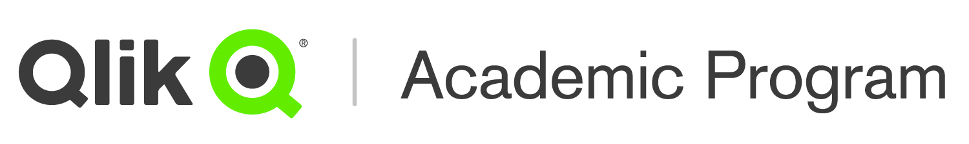
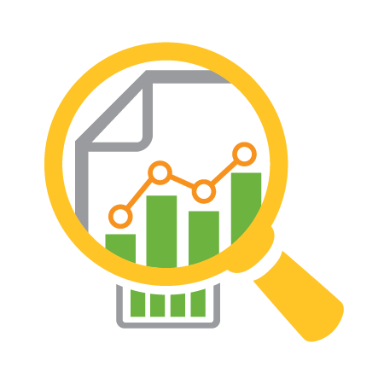


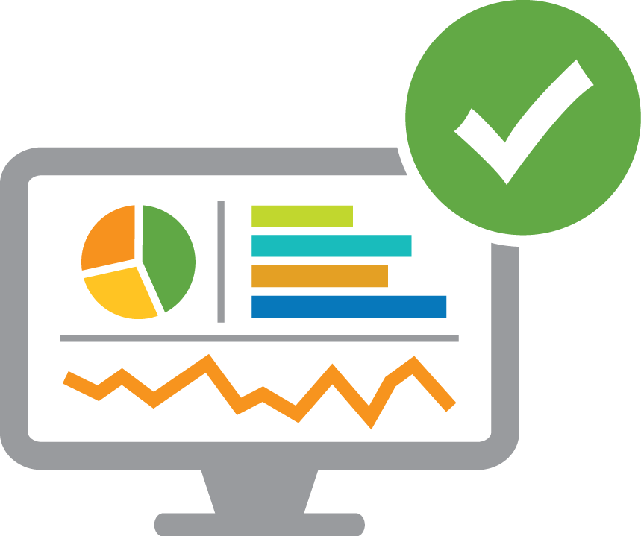


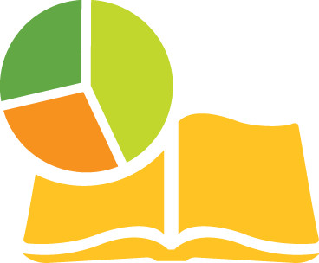





Ecosystem
Analytics
Data Literacy
Qlik
Software
Qlik Continuous Classroom
Qlik Sense Qualification
Data Analytics Curriculum
Support Resources
Qlik Sense® Desktop
Self-service online learning platform
Product exams for specific roles
Lecture notes &
course materials
Qlik Community & private forum
FREE RESOURCES
Qlik Sense® Cloud
Videos & reference guides
Training prep courses
On-demand videos
Qlik Customer Support
Other Qlik products
(on request)
Exercises & quizzes
Printable certificate & digital badge
Student exercises
Direct access to experts
AUDIENCE
Free, full year access. Renew annually.
Professors
Students
Researchers
Notes:
Students preparing for careers in today’s challenging, global data-driven environment need to raise the bar to succeed. They require exceptionally strong analytical and data literacy skills and tools that enable them to keep pace with rapid change and make better decisions faster.
The Qlik Academic Program has been designed to meet this growing demand, by giving students the skills and tools they need to succeed while ensuring that professors are instructing on the most up-to-date data analytics curricula and platforms.
The program provides qualified university professors, students, and researchers with free Qlik software and resources to help educate and train the next generation of expert Qlik users.
Other stats:
Based on a recent PWC publication, Data Analyst continues to be one of the hottest corporate jobs in 2017
A report from the Oceans of Data Institute (ODI), calls for “bringing data literacy to 100 million students by 2021, with the ultimate goal of everyone becoming data literate over time”

Slide 30

Program qualifications
The program is open to any accredited, university-level institution worldwide
Participation will be considered for:
Professors and students who will use Qlik for academic purposes within a qualified academic institution.
Researchers who will use Qlik for academic research involving students associated with a qualified academic institution. Participants may not share their software with anyone outside of the research assignment nor may they use the software for profit.
Notes:
The Qlik® Academic Program is open to any accredited, university-level institution worldwide.
Participation will be considered for:
Professors and students who will use Qlik for academic purposes within a qualified academic institution.
Researchers who will use Qlik for academic research involving students associated with a qualified academic institution. Participants may not share their software with anyone outside of the research assignment nor may they use the software for profit.

Slide 31


How to apply
To apply online visit
www.qlik.com/company/academic-program
New and current participants must apply online annually to continue their membership.
For questions regarding the program, please email academicprogram@qlik.com.
Notes:
To apply online visit www.qlik.com/company/academic-program
New and current participants must apply online annually to continue their membership.
For questions regarding the program, please email academicprogram@qlik.com

Slide 32
David.lyons@qlik.com
Adam.Jacobs@qlik.com
Thank you

